Slide 1

NETWORK TOWER PERFORMANCE ANALYSIS USING PYSPARK
UNDER THE GUIDANCE OF :
Prof. Huma Mam
Prof. Mayur Sir

Slide 2
1.Introduction
2.Raw Data Details
3.Loading Data
4.Data Cleaning
5.Transformations
6.Aggregates Prepared
7.Data Visualization
8.Conclusion

Slide 3

1.Introduction
The project ' Network Tower Performance Analysis using PySpark', focuses on analyzing large-scale telecom data to evaluate the performance of different network towers. Using the distributed computing power of PySpark, the project aims to identify performance bottlenecks, monitor signal quality, and optimize network efficiency for better connectivity and user experience.

Slide 4

2.Raw Data Details
Dataset Name: Network Tower Performance Data
Data Source: Collected from telecom network monitoring system (CSV format)
Total Records: 1000
Total Columns: 12
Signal_Strength
Latency_ms
Tower_ID
Power_status
Network_Type
Temperature_C
Location
Uplink_Utilization
Bandwidth_Mbps
Alarm_Status
Timestamp
Downlink_Utilization

Slide 5
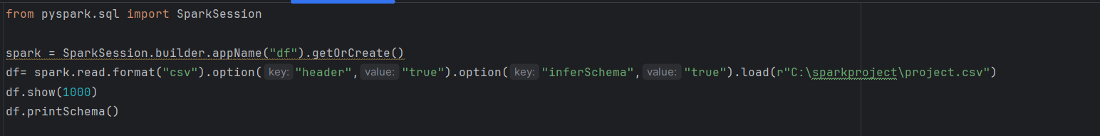
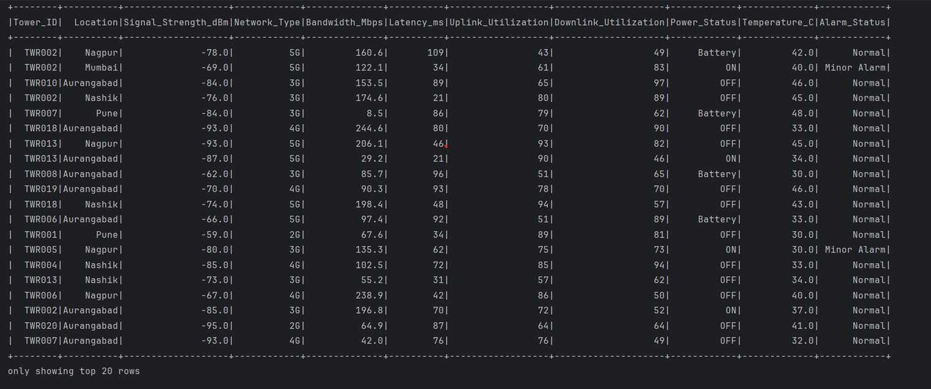
3.Loading Data

Slide 6
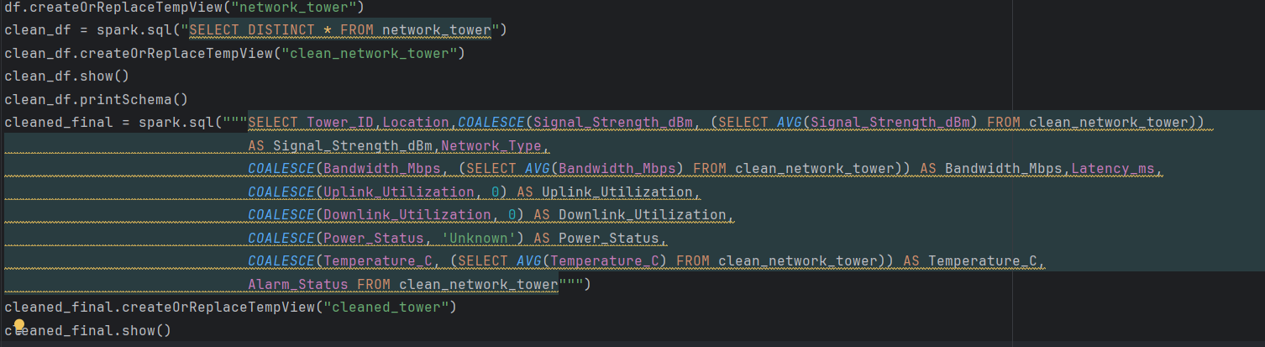
4.Data Cleaning
Removing Duplicate Values
Managing Null Values

Slide 7
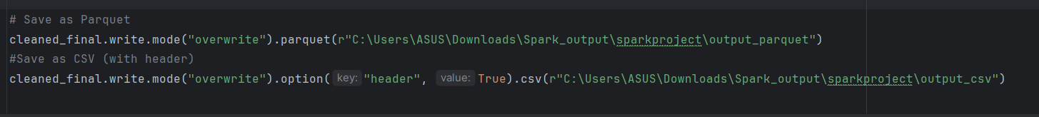
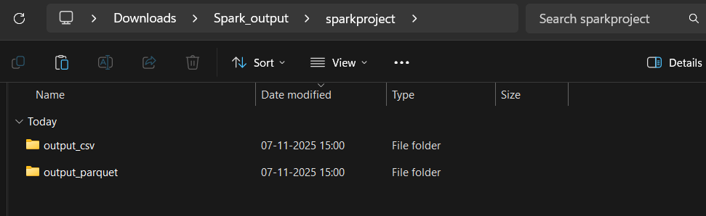
5.Transformation

Slide 8
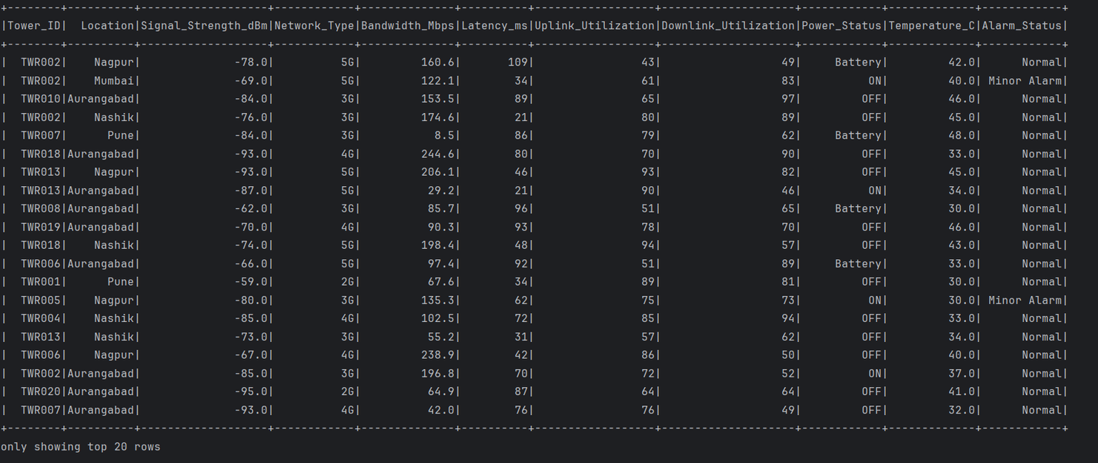
6.Aggregates Prepared
Loading Cleaned Data

Slide 9
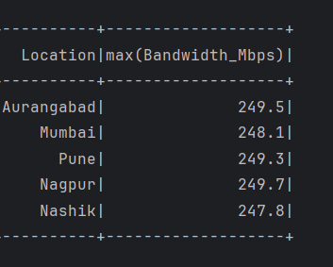
Max Function

Slide 10
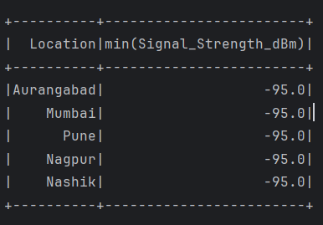
Min Function

Slide 11
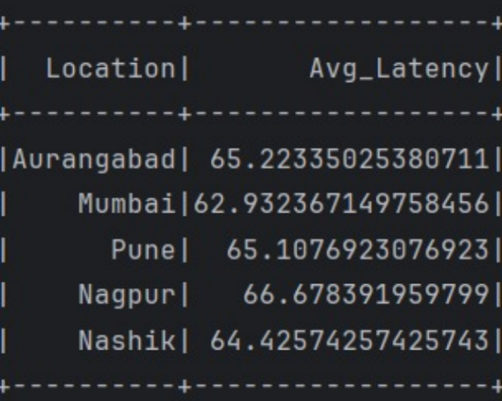
Avg Function

Slide 12
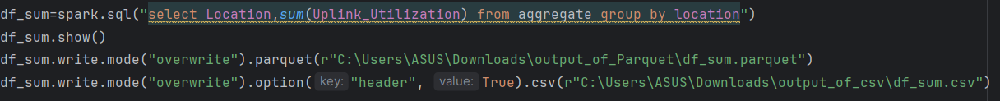
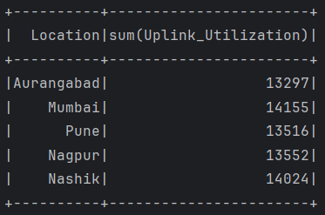
Sum Function

Slide 13
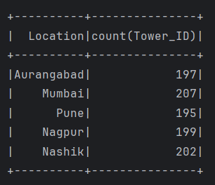
Count Function

Slide 14
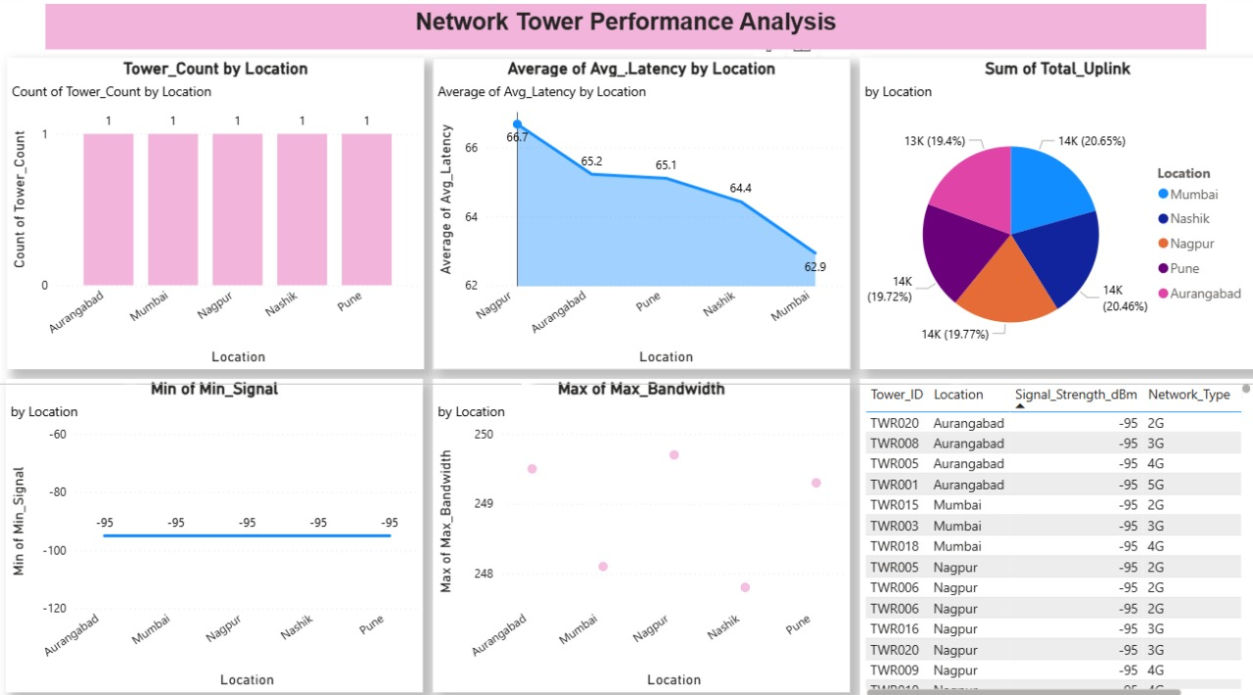
7.Data Visualization
PowerBI

Slide 15
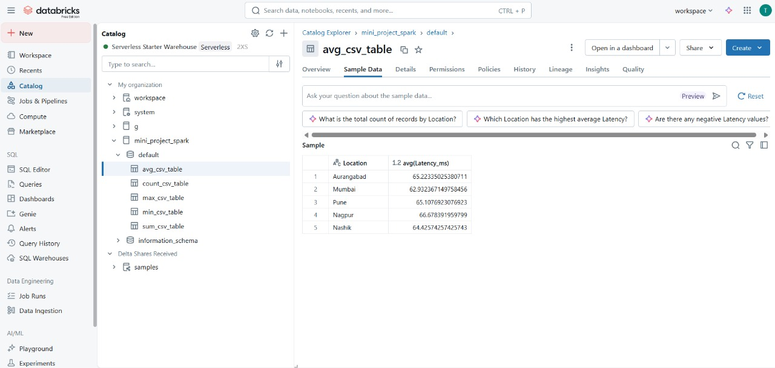
Databricks

Slide 16
04 - Conclusions
The raw dataset was efficiently imported into PySpark using a Spark session.
Schema detection and header options ensured accurate data loading.
This step laid the foundation for data cleaning, transformation, and Power BI dashboard creation

Slide 17
Thankyou

